Slide 1
STOCK MARKETING PREDICTION DASHBOARD

Slide 2
CONTENTS
OBJECTIVE
INTRODUCTION
STEPS TO FOLLOW THE PROJECT
INSTALLING THE LIBRARIES
APPLICATION LAYOUT DESIGN
STYLING OF DASHBOARD
PRECITION USING SVM

Slide 3
OBJECTIVE
The main aim behind this project is to predict the stock market finance using social media affairs like yahoo finance, twitter. The live data is retrieved from yahoo finance and these data is used for prediction using deep learning or machine learning model. The dashboard is used to showcase both the live and predicted data of the stock market.

Slide 4
INTRODUCTION
In this project, we will be developing an interactive dashboard to visualize and forecast the stock data.
We have to extract the live data of various leading companies like Google, Yahoo, Apple, Tesla and many more from yahoo finance social site.
Next, we have to create the prediction model for future prediction of data and visualizing it in the form of graphs

Slide 5
STEPS TO FOLLOW THE PROJECT
INSTALL AND IMPORT THE REQUIRED LIBRARIES
STAGE 1: DESIGN THE DASHBOARD LAYOUT
STAGE 2: STYLE THE DASHBOARD LAYOUT
STAGE 3: EXTRACT DATA AND GRAPHS FROM SOCIAL SITES
STAGE 4: CREATING THE MODEL FOR FUTURE DATA PREDICTION

Slide 6
INSTALL AND IMPORT THE LIBRARIES
The libraries required for designing and layout of the dashboard are:
Dash
Dash-core-components
Dash-html-components
The library used for the external styling of the dashboard in python is:
Flask
The library used to retrieve data from the social media site like yahoo finance and keeping a track on the live trends of the companies is:
Yfinance (yahoo finance)

Slide 7
INSTALL AND IMPORT LIBRARIES
The libraries used building the machine learning model are:
Numpy
Pandas
Plotly
Scikit-learn
Scipy
Sklearn

Slide 8
STAGE 1: DESIGN THE DASHBOARD LAYOUT
For designing the dashboard layout, the python file we created is the app.py which is considered as the main program. The basic layout of the dashboard is developed in this file and the other files will be linked to this main file. The complete code part of the basic layout is described in steps:
IMPORT THE LIBRARIES REQUIRED FOR BUILDING THE DASHBOARD

Slide 9
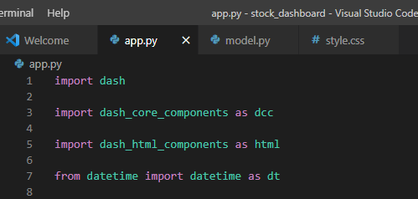
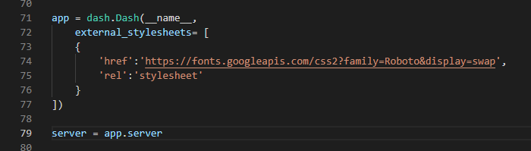
These are the libraries used to create the basic layout of the dashboard. Dash, Dash-core-components, Dash-html-components and datetime for the calender to be used in the dashboard. Creating the dash instance and we can see the stylesheets written within it which is the link for the css file and then comes the server property as the dash will be used frequently.

Slide 10
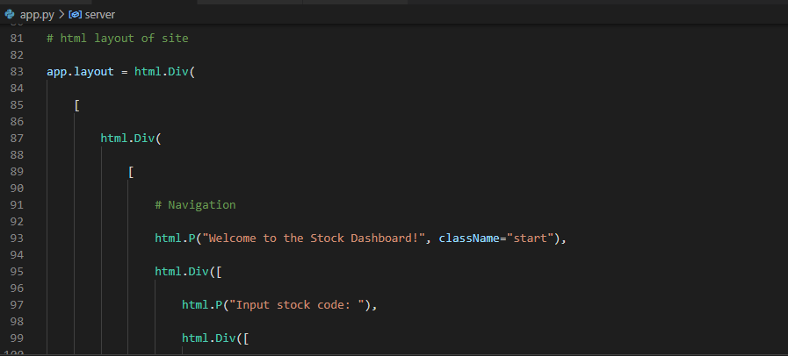
Within the app.layout the complete html layout for the dashboard is written which contains the heading, text bars, buttons, calender being used in the dashboard. There are two html divisions in our code, first division is for the input layouts of the dashboard like stock code, number of days and the buttons in the board. The second division is for the information extracted about the companies from the social site yahoo finance and the live plots of the stock.

Slide 11
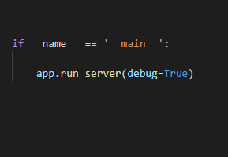
This is the last part of the layout code for running the dashboard in development mode. The app.py also contained call backs and those are: -call back for company information -call back for stock graphs -call back for indicators -call back for forecast The call backs are for the generation of information and graphs for the company so, it will be further described in third stage. The call backs are done to update the blank sections in the second html.div.

Slide 12
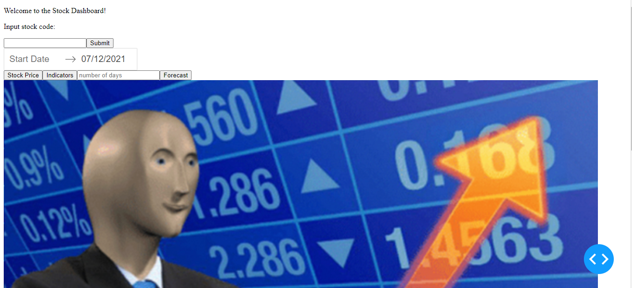
This is the raw form of dashboard after executing the above written steps but it’s not the final one. We will be doing some changes to this dashboard in stage 2 by giving it a different interactive look.

Slide 13
STAGE 2: STYLE THE DASHBOARD
For styling the dashboard, the style sheet we created is style.css. It is linked with the main python file(app.py) using href , where the external link of css file is provided and rel.
This is about the linking of the cascading stylesheet (css) with the python file.

Slide 14
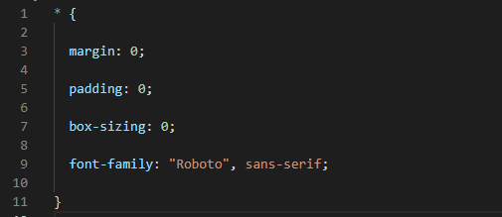
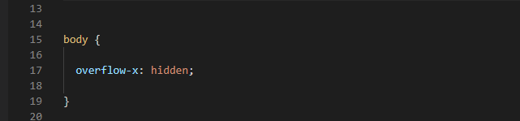
Here, we have used the selector(*) for giving style to the entire dashboard. The parameters we mentioned here are margin, padding, box-sizing and font. In the body tab, the overflow property is specified and overflow hidden means, the overflow is clipped and it is non-scrollable. The remaining content is not visible we can also change this hidden to scroll or auto but visible is by default. .

Slide 15
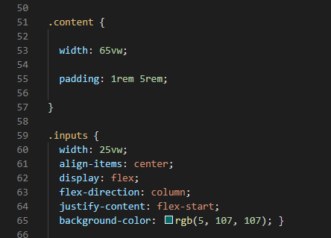
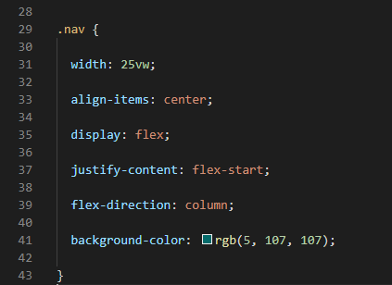
In the container division, the display property is given flex value which ensures that the divison in the dash is laid out in the same horizon.
In the navigation division, the styling f the navigation bar is provided which consists of the width, align to centre, display and colour properties are provided.
In the content division, the styling of the content to be displayed is done by providing width and padding properties.
In the inputs division, the styling of the user input section is done by again providing the display, width, align, background colour and many more.

Slide 16
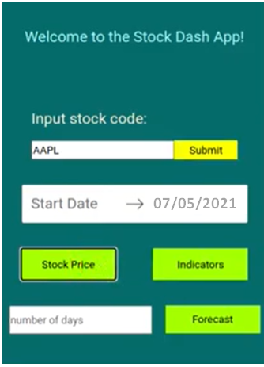
This is the final interactive look of our stock prediction dashboard after styling. Further, in the stage 3, we will generate the maps and information about the site yahoo finance by adding callbacks to the main file(app.py).

Slide 17
Till now, we are only done with the layout and styling of the dashboard which we have discussed above in Stage 1 and Stage 2. Further in Stage 3 and Stage 4, we will generate the information from the site and display them in the dashboard and forecast the future trends. These are the steps we are yet to go through but we will discuss about the plans of these two remaining stages in brief.

Slide 18
STAGE 3: EXTRACT DATA AND GRAPHS FROM SOCIAL SITES
We will extract data from the social site yahoo finance which contains the live stock trends and description about the leading companies like Apple, Amazon, Google, Yahoo, Tesla and many more.
For getting updates based on the inputs, we will write the call back functions in the main python file(app.py)
Call backs will be done to update the empty fields in the basic layout of the dashboard for the company information, stock graph and indicators
After the implementation of this, the dashboard is partially functional and the forecasting of future trends will complete the functionality of dashboard.

Slide 19
STAGE 4: CREATING THE MODEL FOR FUTURE DATA PREDICTION
A new python file will be created for creating the stock prediction model.
After the complete coding of the new file is done, another callback function will be written in the main file(app.py) to import the model.
We will try to built the machine learning prediction model using the support vector model by splitting the data to test and train data in 9:1 ratio.
Finally, the model performance and accuracy will be checked on the testing data.

Slide 20
REFERENCES
https://medium.com/@jjsham/building-stock-price-dashboard-with-plotly-dash-part-i-b165b3edfdd6
https://www.datacamp.com/community/tutorials/learn-build-dash-python#:~:text=Dash%20App%20Layout%20A%20Dash%20application%20is%20usually,enable%20us%20to%20generate%20HTML%20content%20with%20Python
https://www.w3schools.com/Css/
https://www.w3schools.com/Css/css_navbar.asp

